Slide 1

:: Team :: Achievers
:: Problem Statement Title ::
Exploring India’s Rich Cultural Heritage and Traditions
:: Prepared by ::
Jay A. Modi
Apexa R. Solanki
Akshesh S. Patel
Anu R. Patel
Riya M. Patel
Palak S. Dhobi

Slide 2
Introduction
India is a land of rich cultural heritage and tradition. It is home to four major world religions: Hinduism, Buddhism, Jainism, and Sikhism, as well as a variety of other religions and faiths. This diversity is reflected in India's culture, which is a vibrant tapestry of languages, music, dance, art, architecture, cuisine, and festivals.
India's cultural heritage is rooted in its ancient history. The Indus Valley Civilization, which flourished around 5,000 years ago, was one of the earliest civilizations in the world. The Vedic Age, which followed, saw the development of Hinduism and other Indian religions. Buddhism and Jainism also emerged in India during this period.
Over the centuries, India has been influenced by a variety of cultures and civilizations, including the Persians, Greeks, Arabs, Mughals, and British. This has led to a rich and diverse cultural heritage that is unique to India.

Slide 3
Objective
Education and Awareness
Exploration and Discovery
Preservation and Promotion
Interactivity and Engagement
Global Connection
Resource Hub
Inspiration for Travel
Celebration

Slide 4
Purpose
The website is aimed at a wide audience, including:
Students who are interested in learning more about Indian culture
Tourists who are planning to visit India
People of Indian descent who want to learn more about their heritage
Anyone who is interested in learning more about the world's cultures
The website is a valuable resource for anyone who wants to learn more about India's rich cultural heritage and tradition. It is comprehensive, engaging, accessible, and affordable.

Slide 5
Purpose
In addition to the educational purpose, the website can also be used to:
Promote cultural tourism in India
Preserve India's cultural heritage
Educate people about the rich and diverse cultural heritage of India.
Inspire people to learn more about Indian culture and to visit India to experience it firsthand.
Overall, the Exploring India's Rich Cultural Heritage and Tradition website is a valuable resource for anyone who wants to learn more about India's rich cultural heritage and tradition. It is a comprehensive, engaging, accessible, and affordable way to explore the many wonders of Indian culture.

Slide 6
Our Website
It offers a wealth of information on topics such as:
Religion & Spirituality
History & Culture
Art & Architecture
Music & Dance
Food & Cuisine
Festivals & Celebrations
Languages and Literature

Slide 7
Who should Explore
Cultural Enthusiasts
Students
Educators
Travelers
Researchers
Anyone who is curious about India’s culture

Slide 8
Why people choose this System
Easy to implement
Comprehensive
Engaging
Affordable
Accessible from anywhere with an internet connection

Slide 9
Tools & Technologies
Software Requirements: Server-Side Requirements(to be used): Operating System : Windows Front-end Language : HTML, CSS, JS, JQuery Client-Side Requirements: Operating System : Windows, MAC, Linux, Android Browser : Any web browser

Slide 10
Tools & Technologies
Hardware Requirements: Server-Side Requirements(to be used): Processor : intel i5 Hard Disk : 1TB RAM : 4GB Client-Side Requirements(Preferable): Processor : intel i5 Hard Disk : 1TB RAM : 4GB

Slide 11

Snapshot

Slide 12
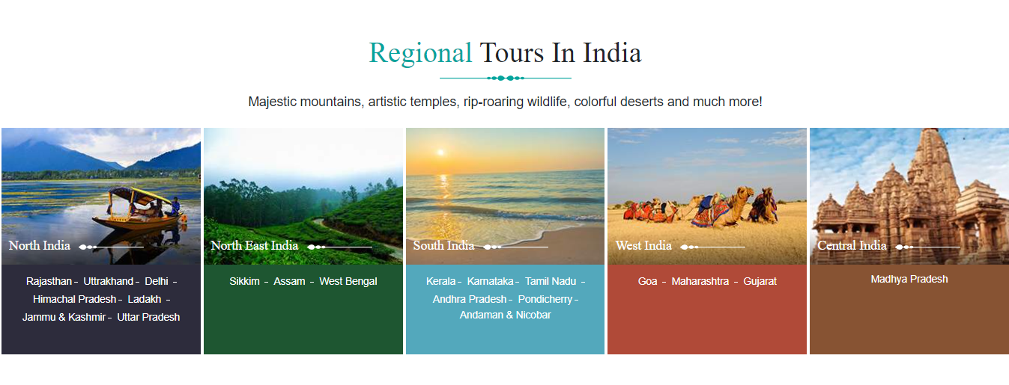
Snapshot

Slide 13
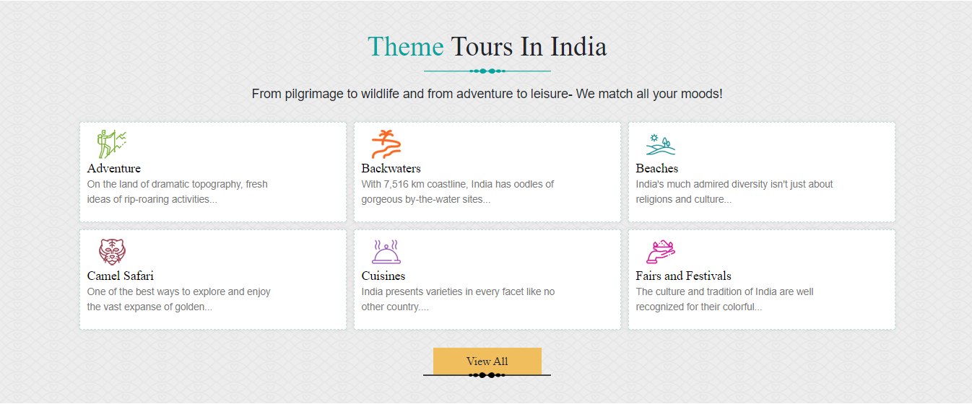
Snapshot

Slide 14
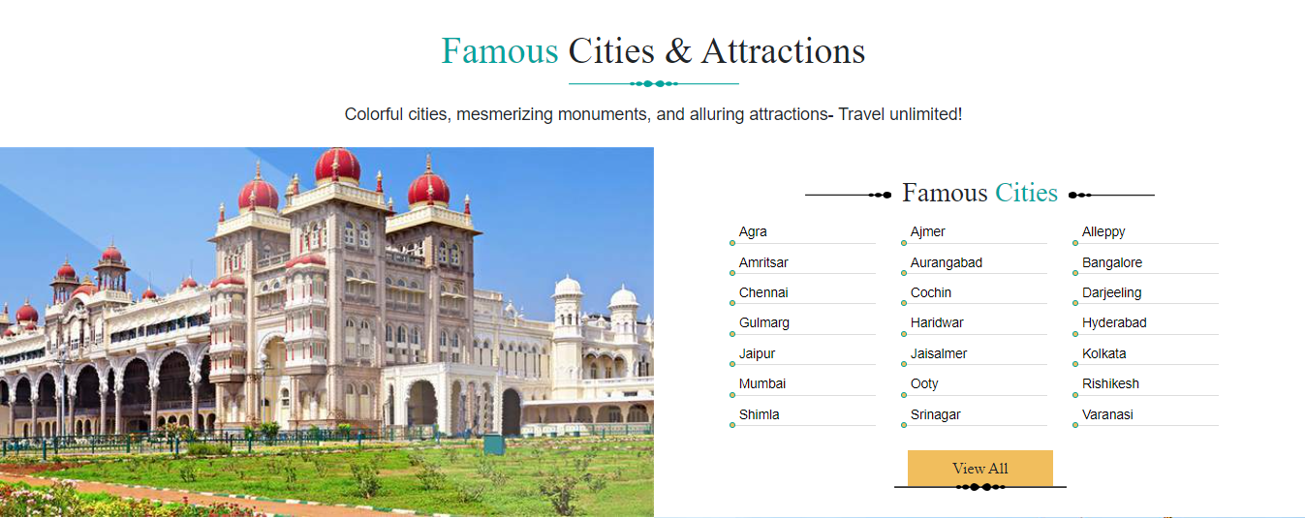
Snapshot

Slide 15
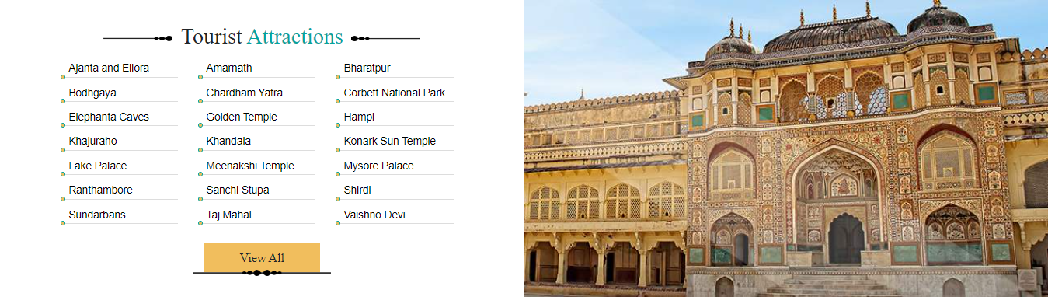
Snapshot

Slide 16
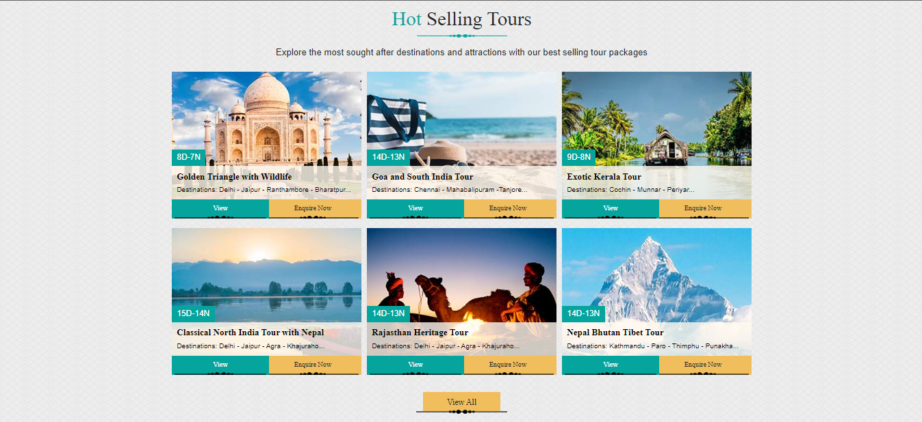
Snapshot

Slide 17
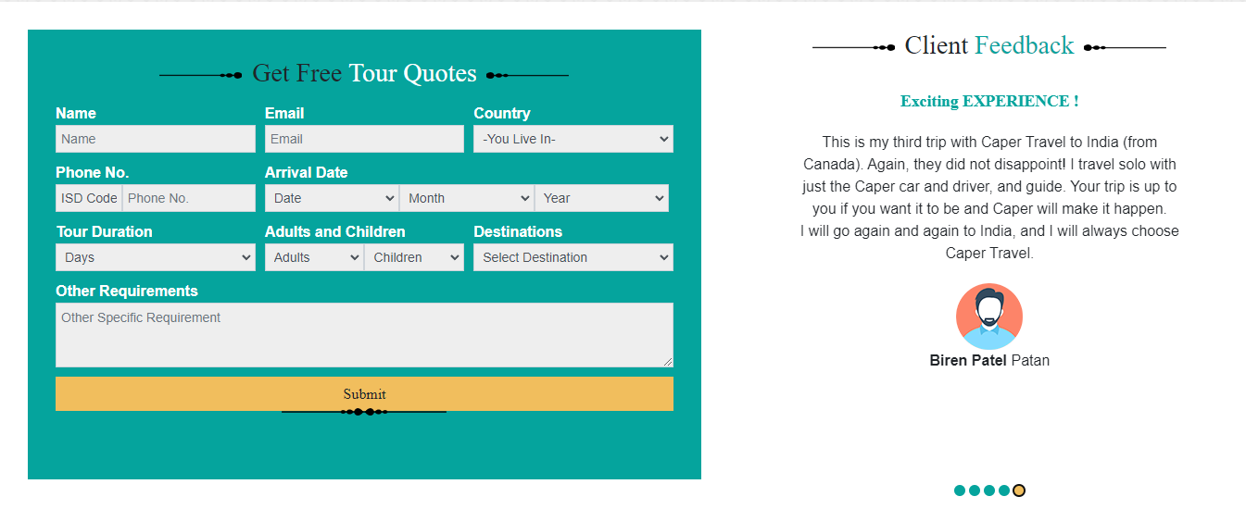
Snapshot

Slide 18
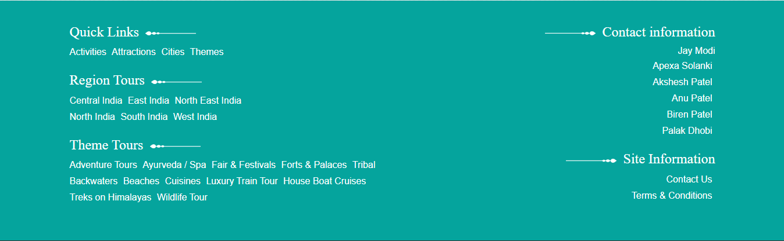
Snapshot

Slide 19
Conclusion
India’s rich cultural heritage is a source of pride and inspiration, connecting the past with the present
Let’s cherish and protect this treasure for generations to come.
Our project is a valuable resource for anyone who wants to learn more about India’s rich cultural heritage and traditions. It is a well-organized and easy to navigate, and it provides a wealth of information on a wide range of topics.

Slide 20
Thank You :)

